Slide 1
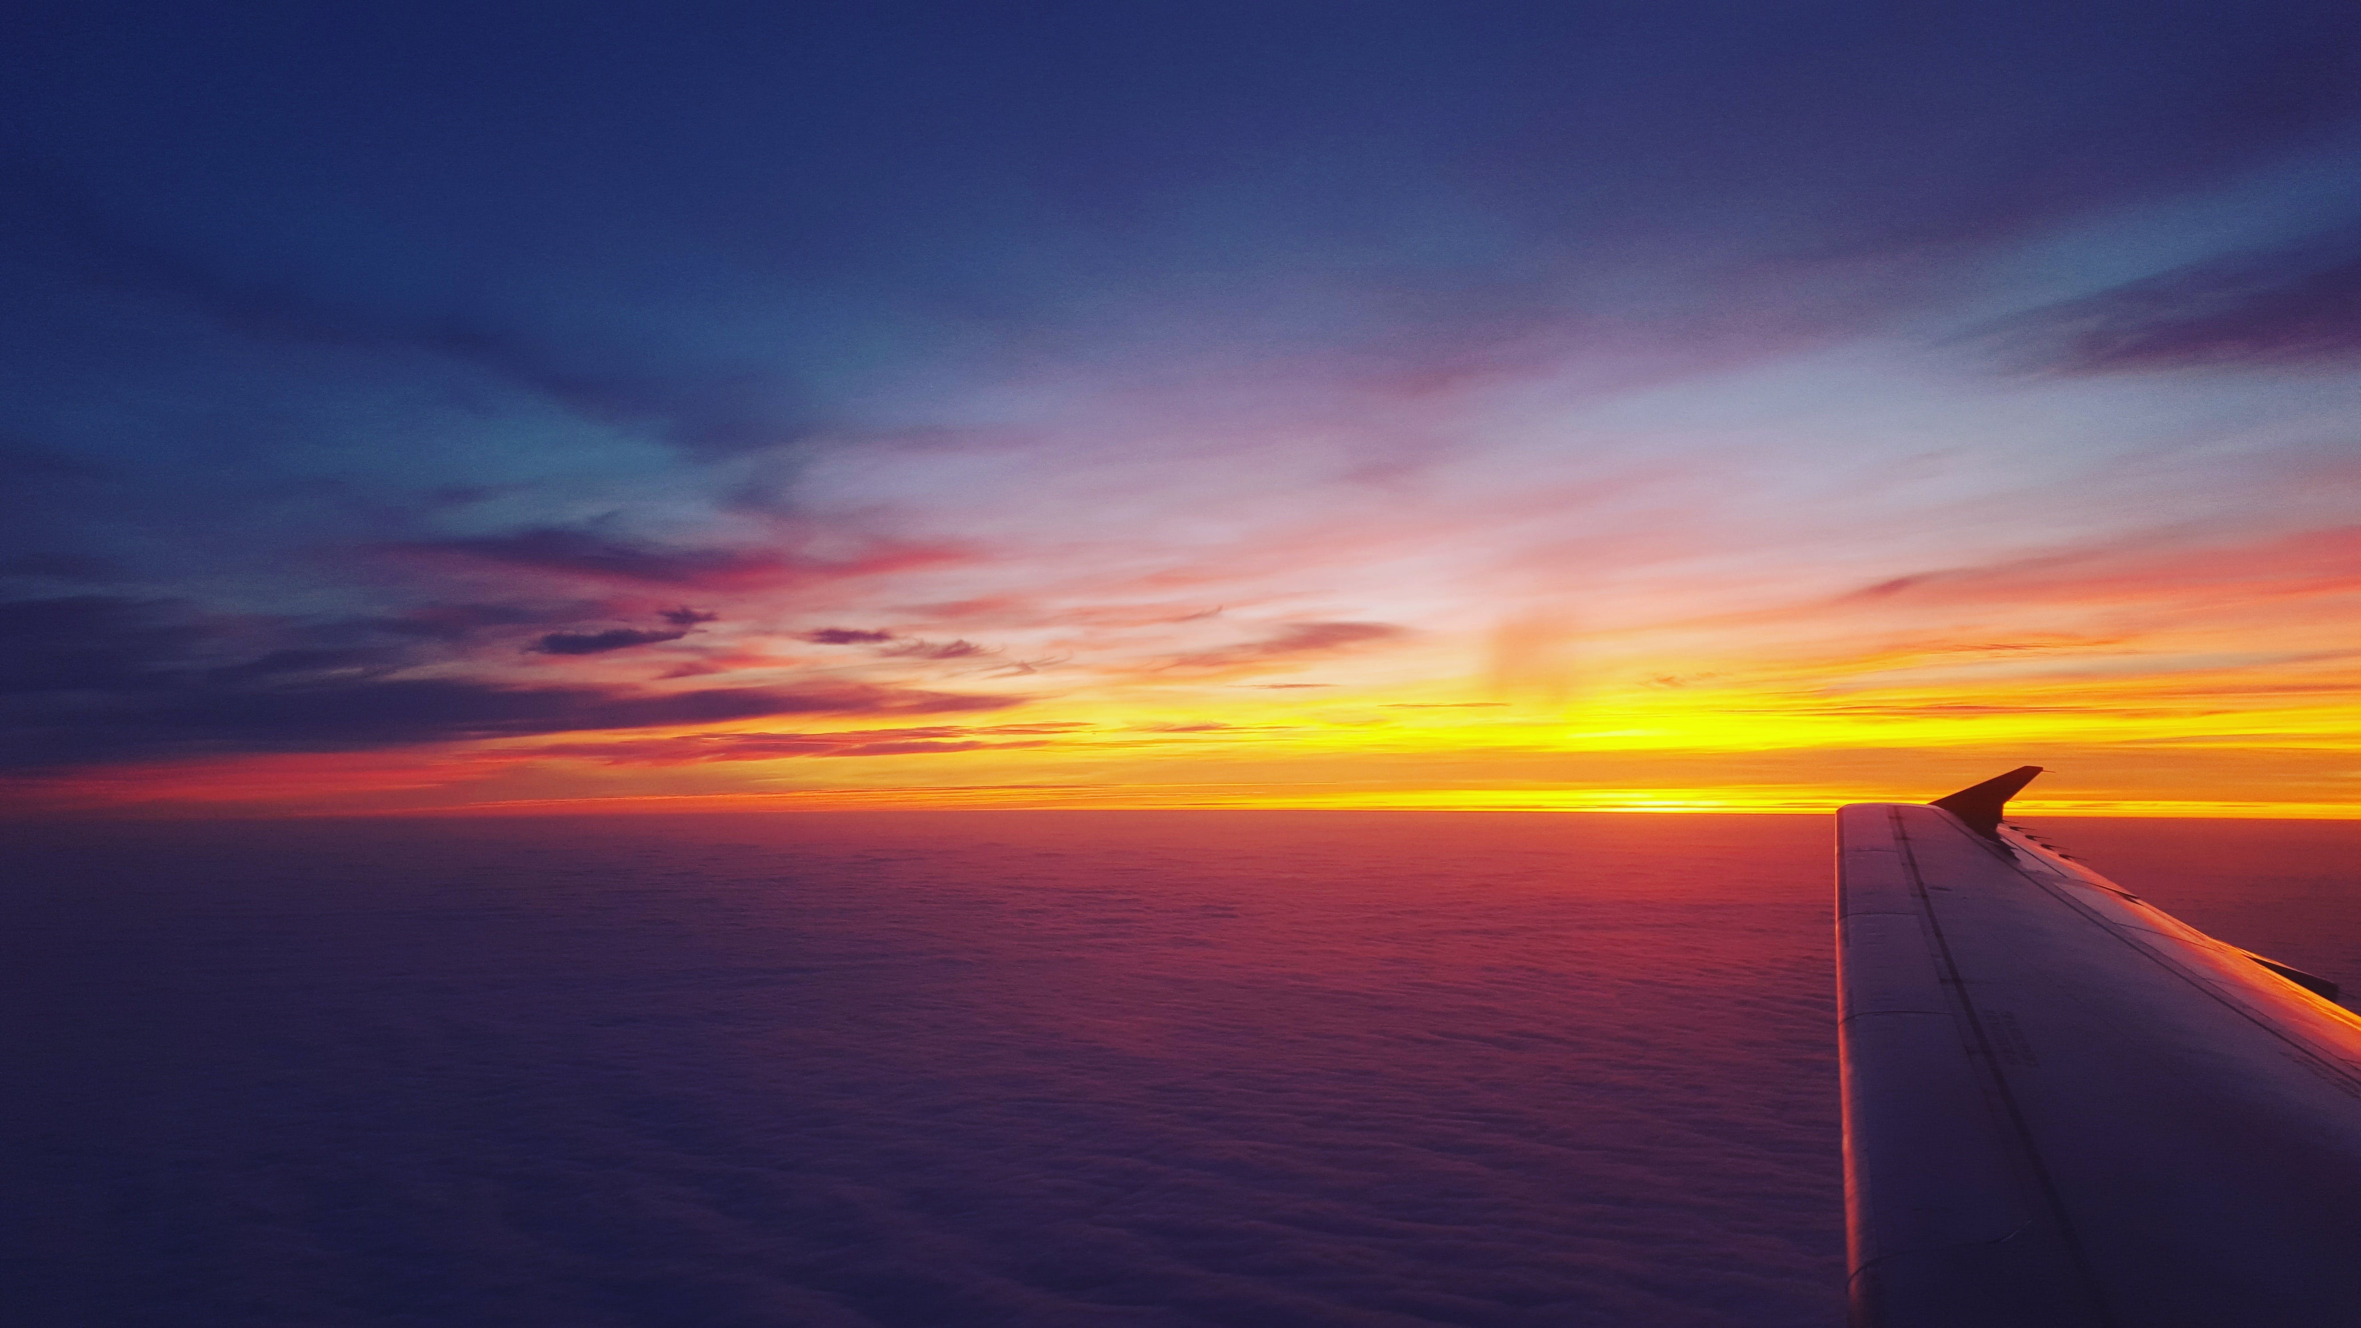

TAKE FLIGHT with USA Airlines
Notes:
Hi there! Welcome to USA Airlines. Take a journey with me as we discover how to support making your dreams come to life.

Slide 2
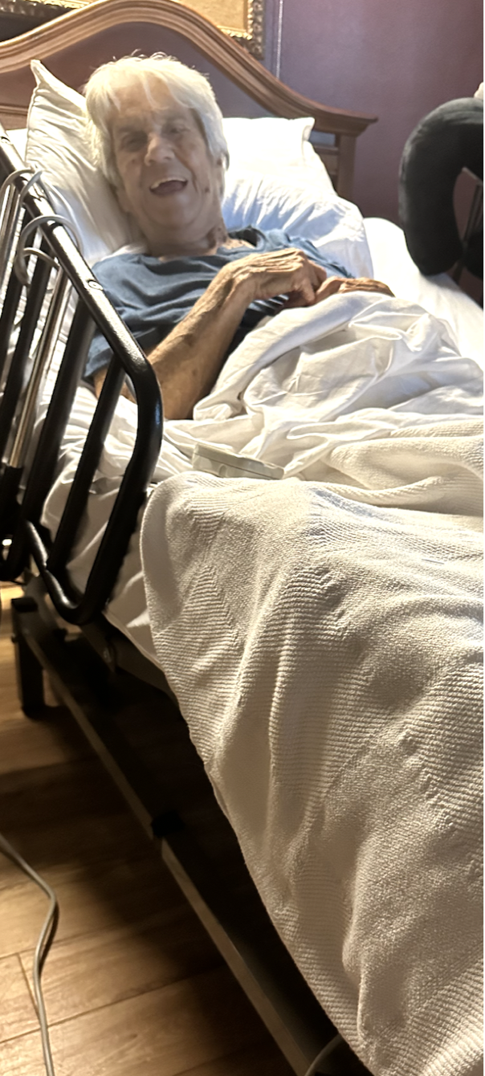
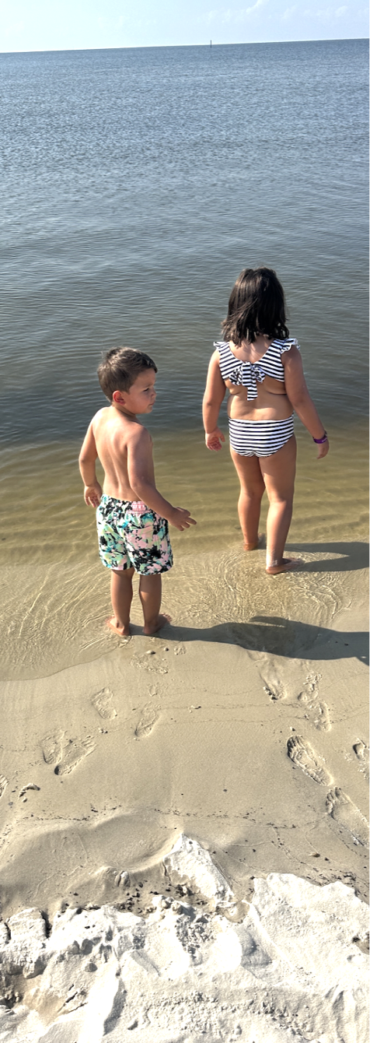
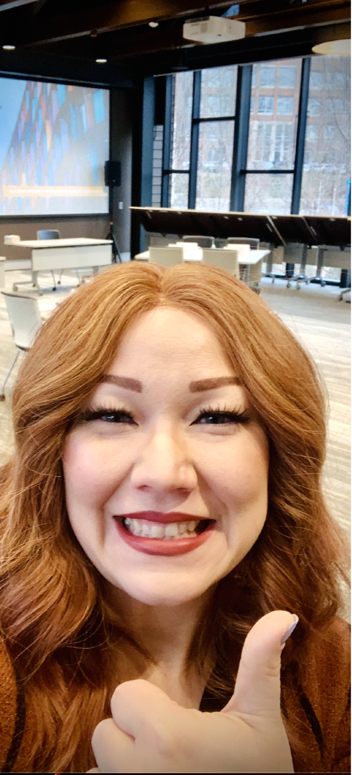


VISIT LOVED ONES
FAMILY VACATIONS
BUSINESS MEETINGS
TRAVEL THE WORLD
GRANT WISHES
“Thanks USA Airlines…
… for making my dreams come true”
Notes:
At USA Airlines, it's our mission to connect you to what's important.
vising loved ones that live far away,
making memories on beach vacations,
connecting with long distance work teammates, experiencing the wonders of the world,
or granting last wishes.
USAA is here to help make the things that are important in your life possible.

Slide 3

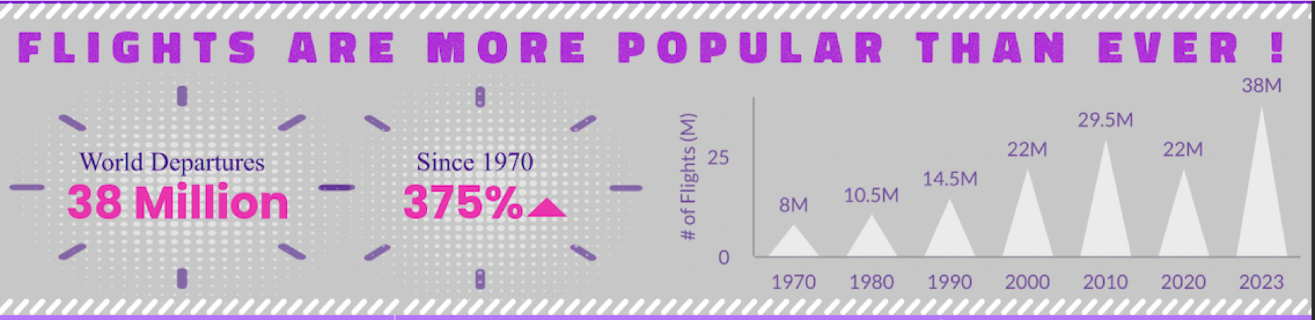
Notes:
whatever the case may be,
People are traveling more than ever!
And the quickest way to get from point A to B is by flying!
We're contantly growing our team to meet your demand.

Slide 4
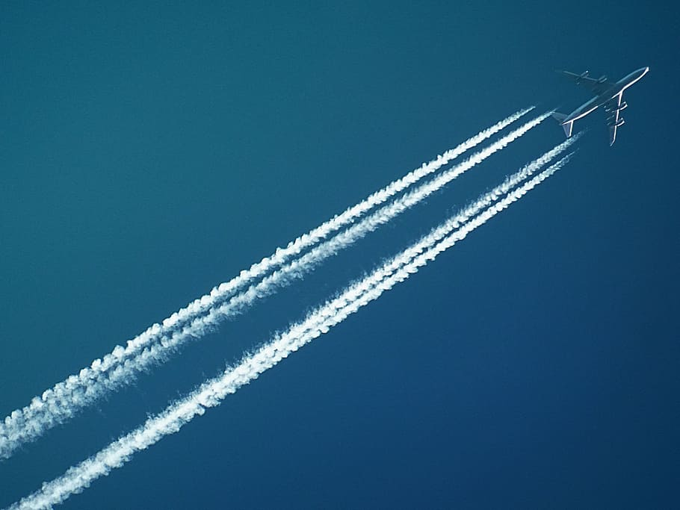

“Time is the most valuable thing a man can spend” – Theophrastus
Notes:
In our world today. Time is of the essence. Let us help!

Slide 5


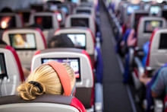

WHY
FLY?
Creative Thinking
Multitask
Rest
Connect
Most
importantly…

Slide 6
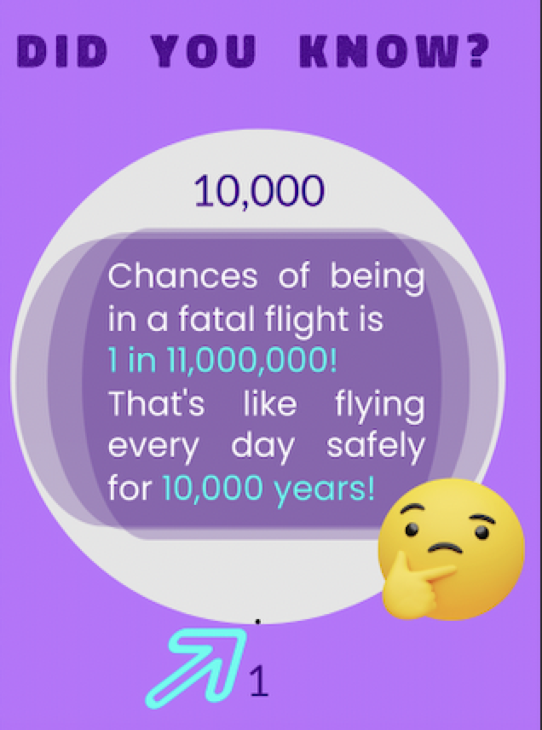
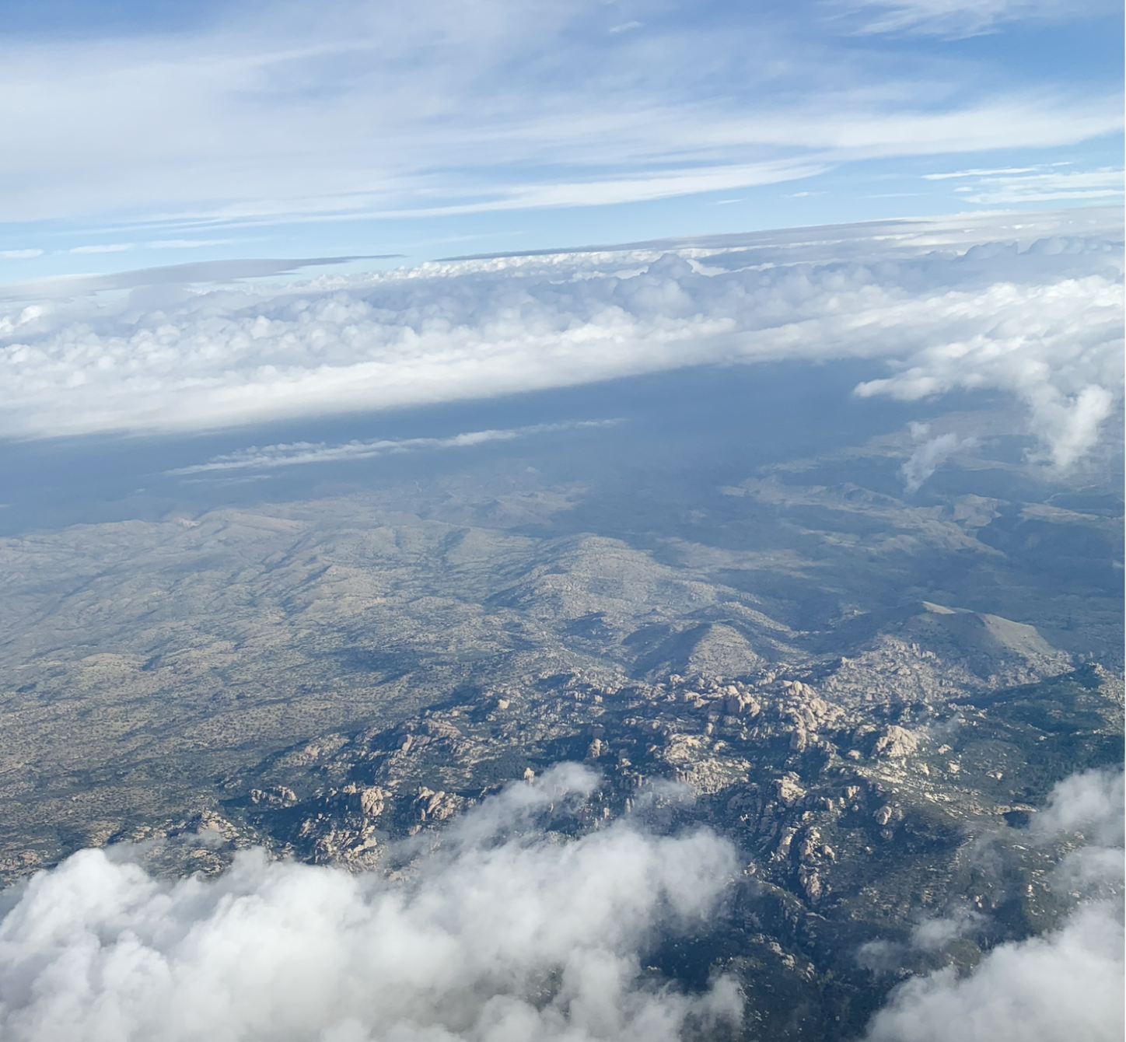

FLYING IS THE SAFEST WAY TO TRAVEL!

Slide 7

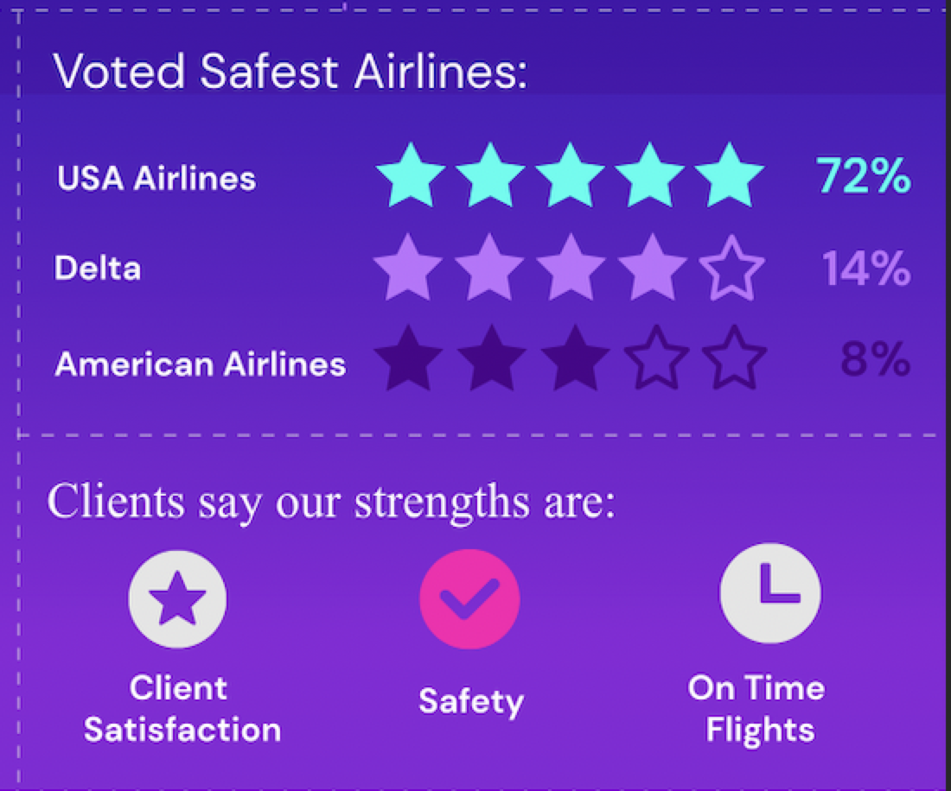
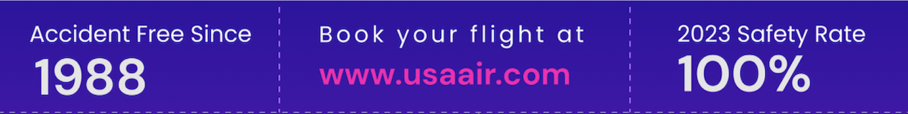
CONNECTION
CONSISTENCY
CONROLLED
CONFIDENT
Notes:
When you need quick and safe travel, depend on USA Air to connect you to what's important in your life.
We deliver a consistent client experience that exceeds you expectations.
We prioritize control measures to ensure a safe flight.
Confide in us to bring you home.
You can find out more at www.usaair.com

Slide 8
Sources
Federal Highway Administration.
Fatality Analysis Reporting System (FARS).

